Slide 1
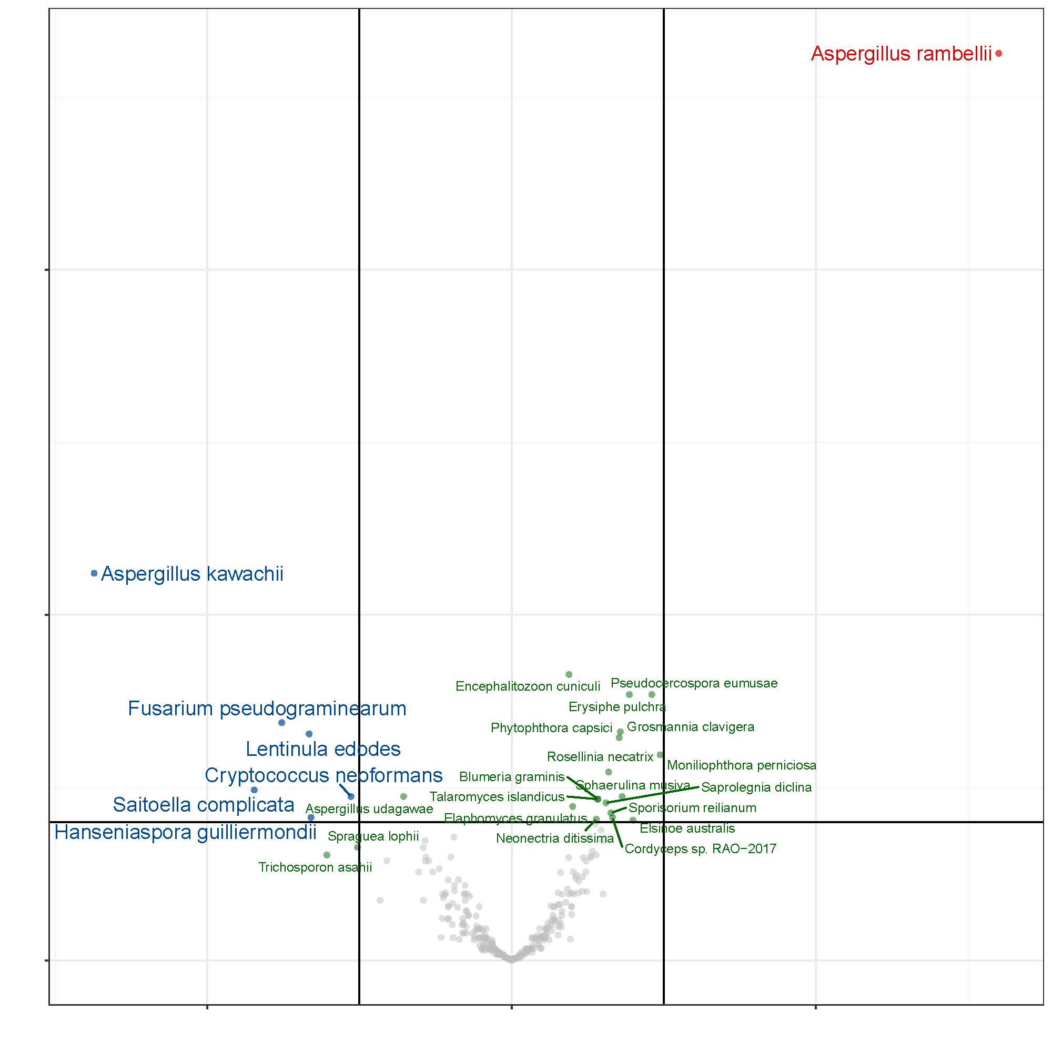
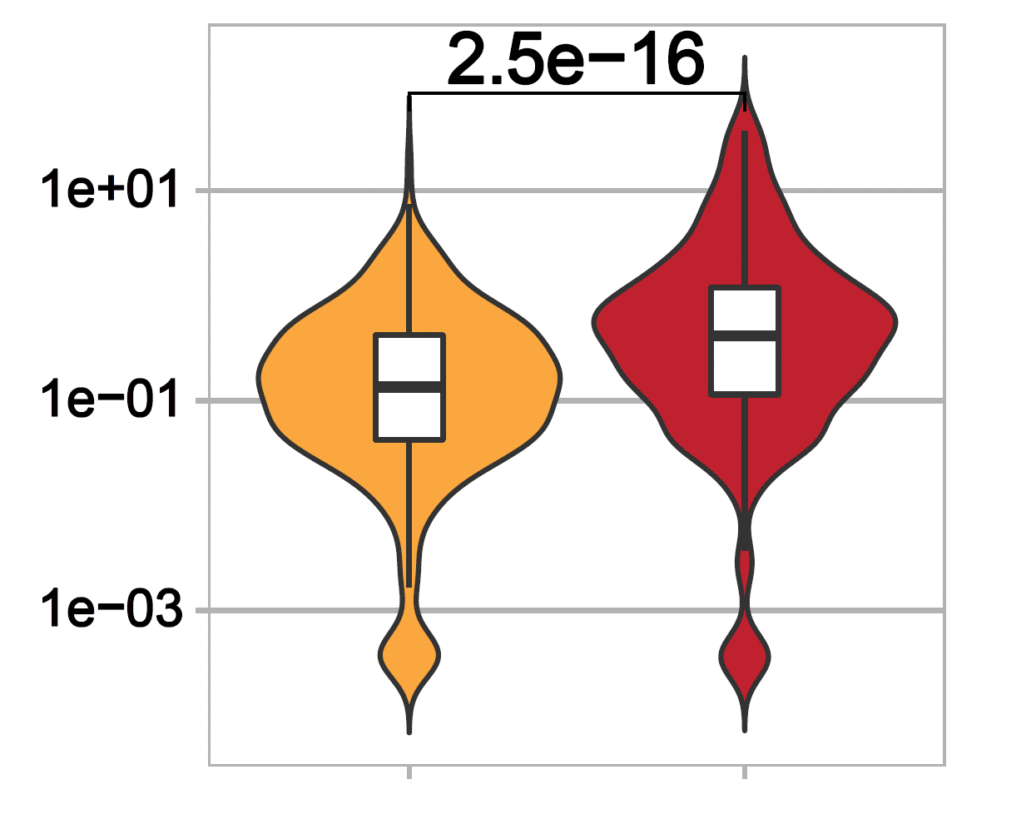
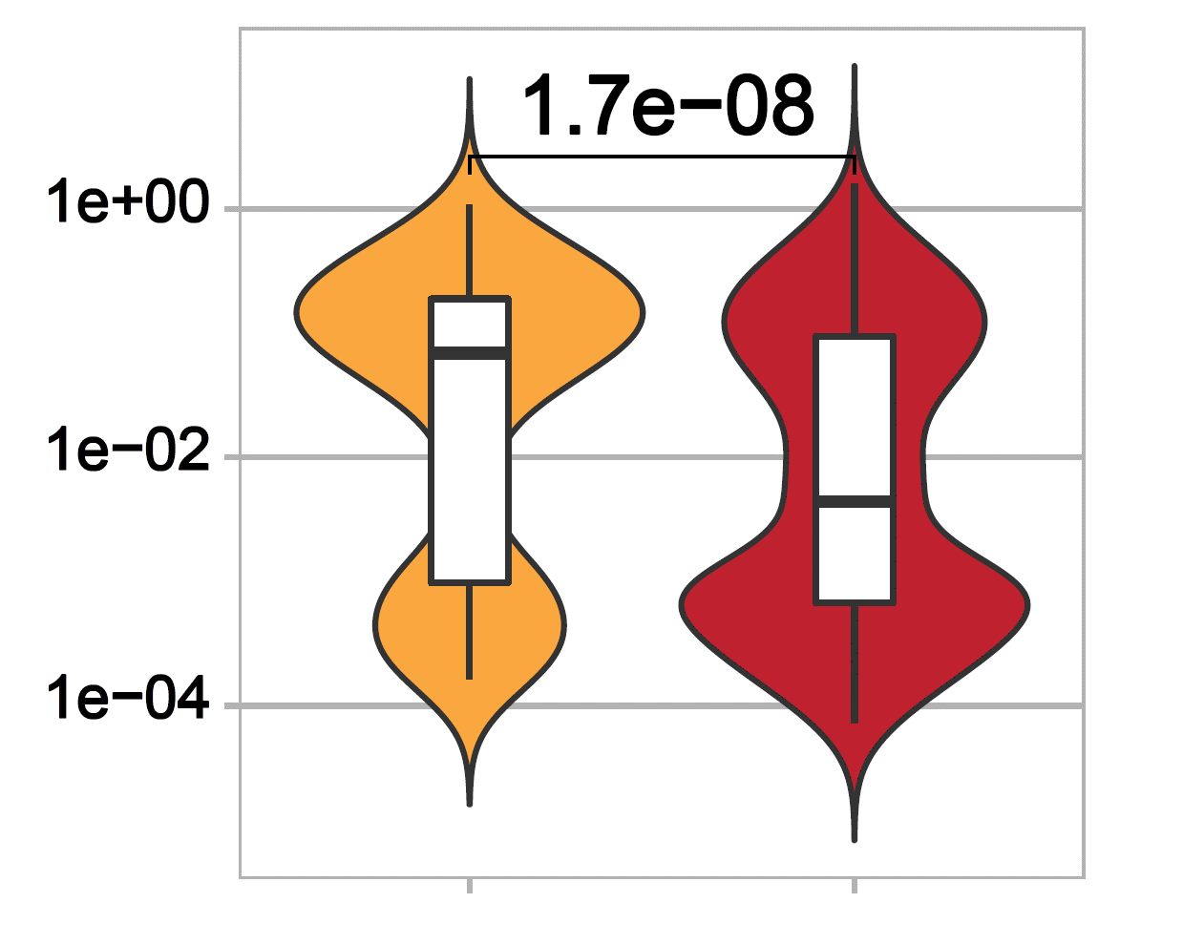
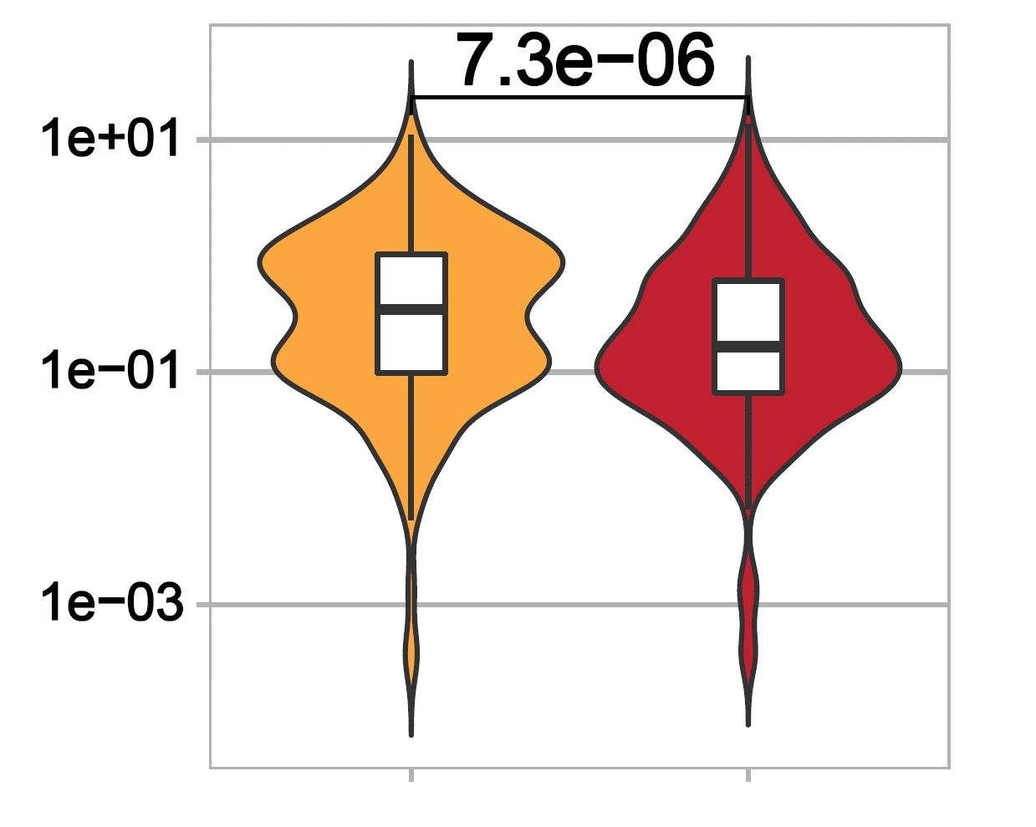
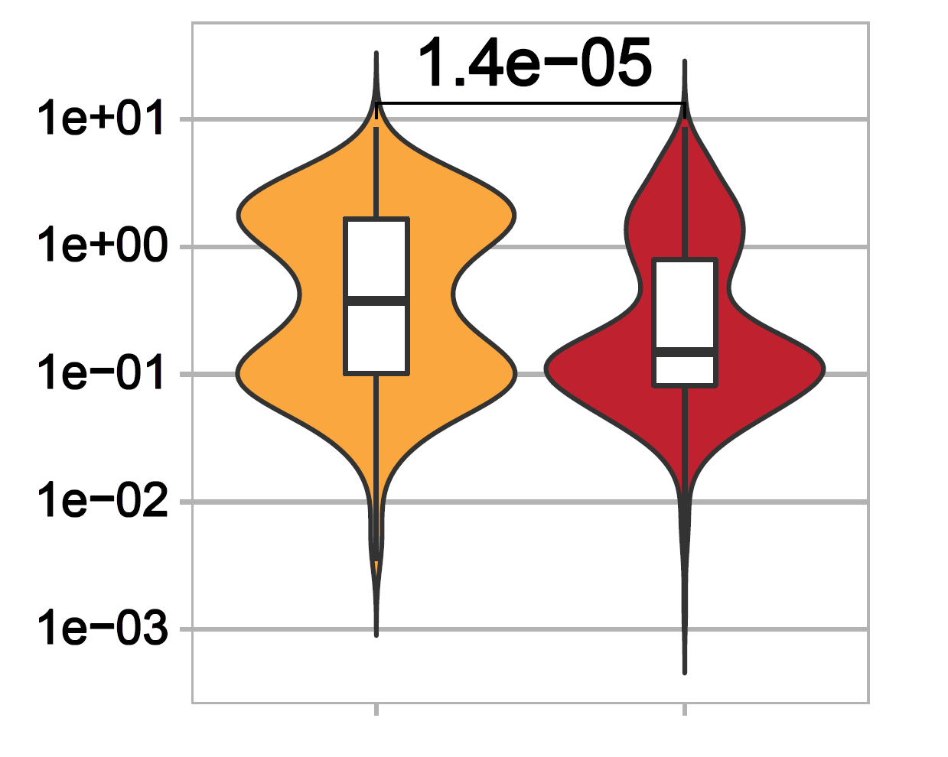
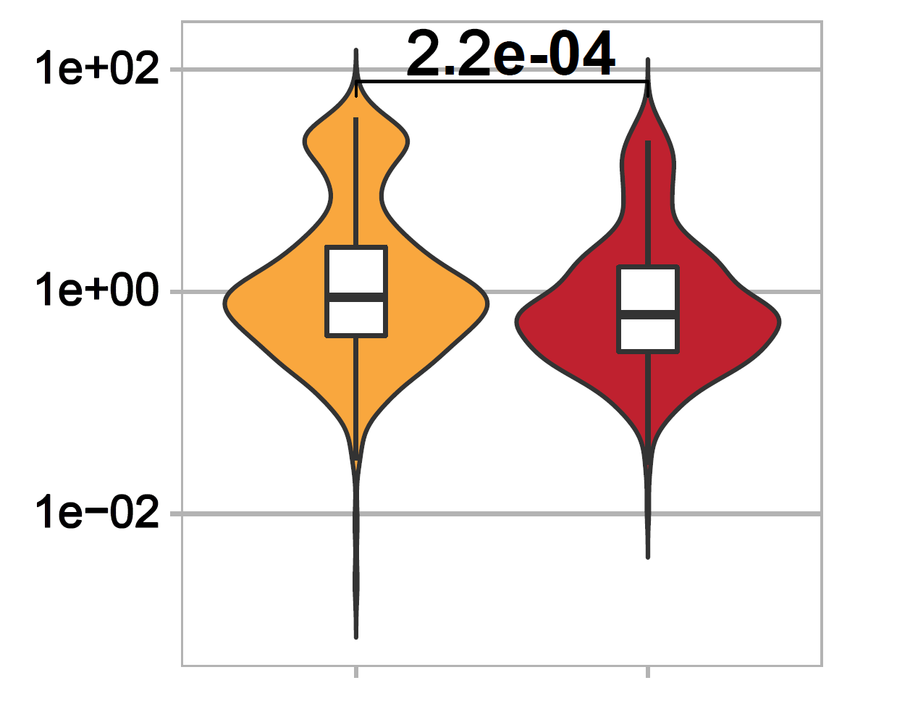
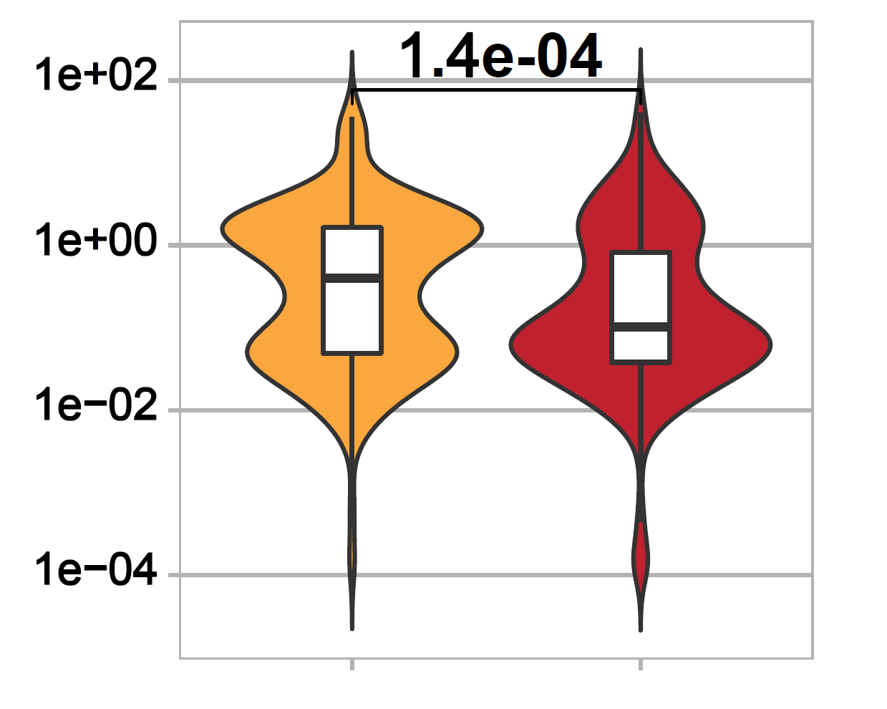
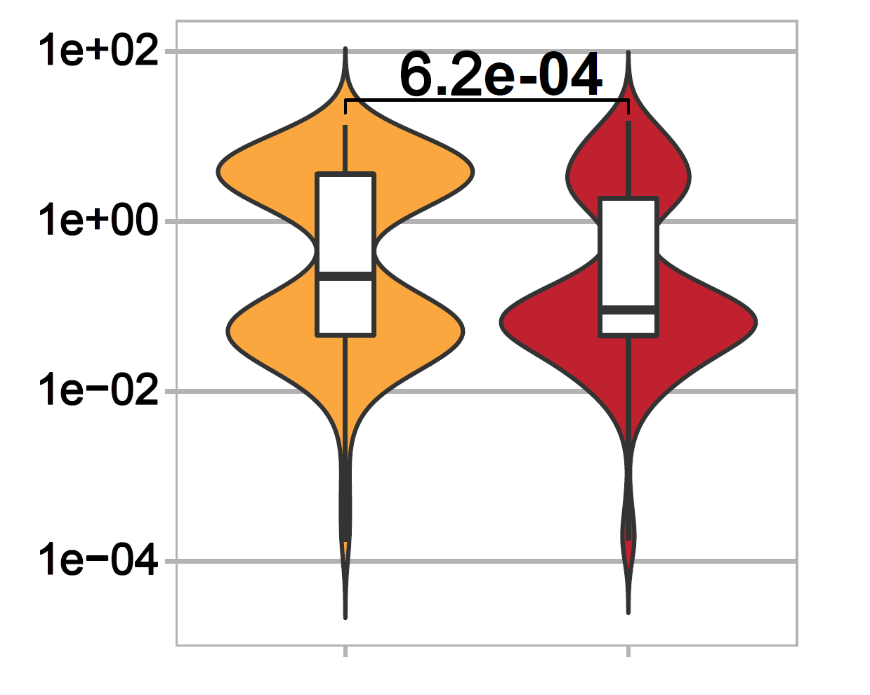
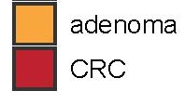
a
b
Aspergillus rambellii
Aspergillus kawachii
Fusarium pseudograminearum
Lentinula edodes
10
- log₁₀ FDR
Cryptococcus neoformans
Saitoella complicata
Hanseniaspora guilliermondii
5
-1.0
0
-0.5
0.0
0.5
1.0
log₂ FC
S figure 3. Significant Different fungi in CRC compared with adenoma. (a) Volcano plot explored the extremely different fungi in CRC compared with adenoma. The log₂ FC indicates the mean expression level of each fungi. Each dot represents one fungus. The blue and red dots represent CRC down- and up-regulated species, respectively. Between the CRC group and adenoma, the green and gray dots show significant fungus and no significant difference alternatives, respectively. (b) Violin graph for the seven outstanding performance fungi. The adenoma and CRC groups are shown by yellow and red colors, respectively.

